Slide 1
ALDAR University College
School of Engineering and Technology
I/O Interfacing
Dr. Osama Hosameldeen

Slide 2
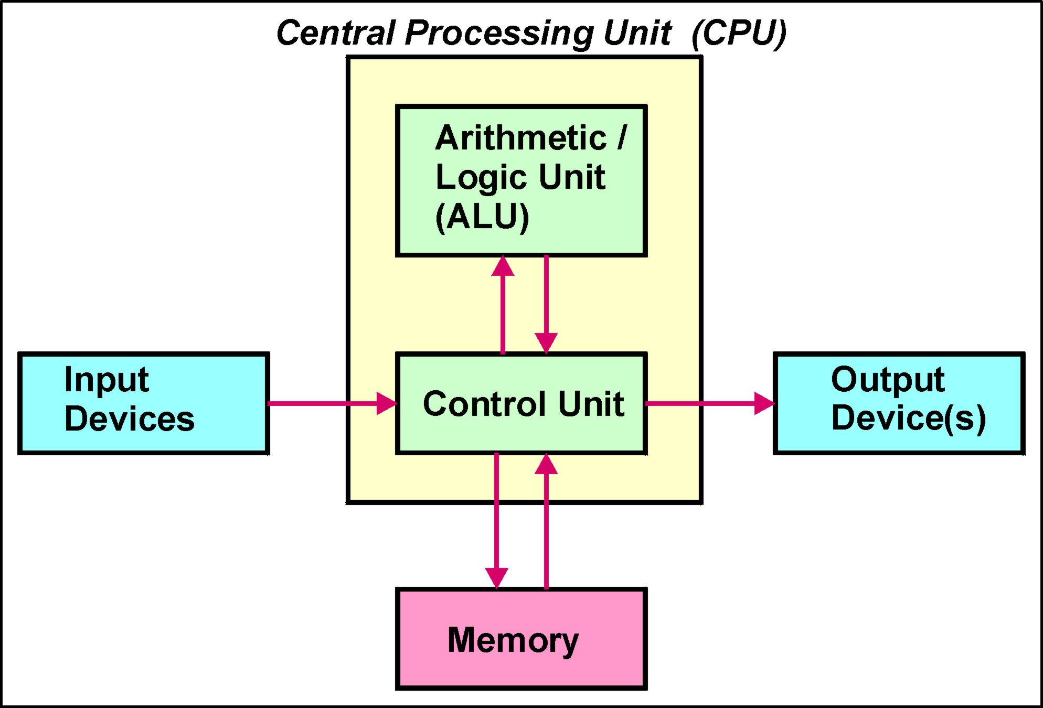
Basic Architecture of a Digital Computer

Slide 3
Microprocessor
A microprocessor is a single, digital integrated circuit that performs the function of a central processing unit ( CPU ).
A microprocessor is a collection of digital circuits that: process binary data provide control and timing references

Slide 4
Memory System
The memory system of a computer is used to :
  Store the programs the computer is required to execute
  Store the data that is to be processed by those programs
Information is stored in memory in binary form.
There are many memory locations in the memory system of a digital computer.
Each memory location can store n binary digits (n-bits). N is usually an integer multiple of 8.
Each memory location is given a unique identifier, called its address.

Slide 5
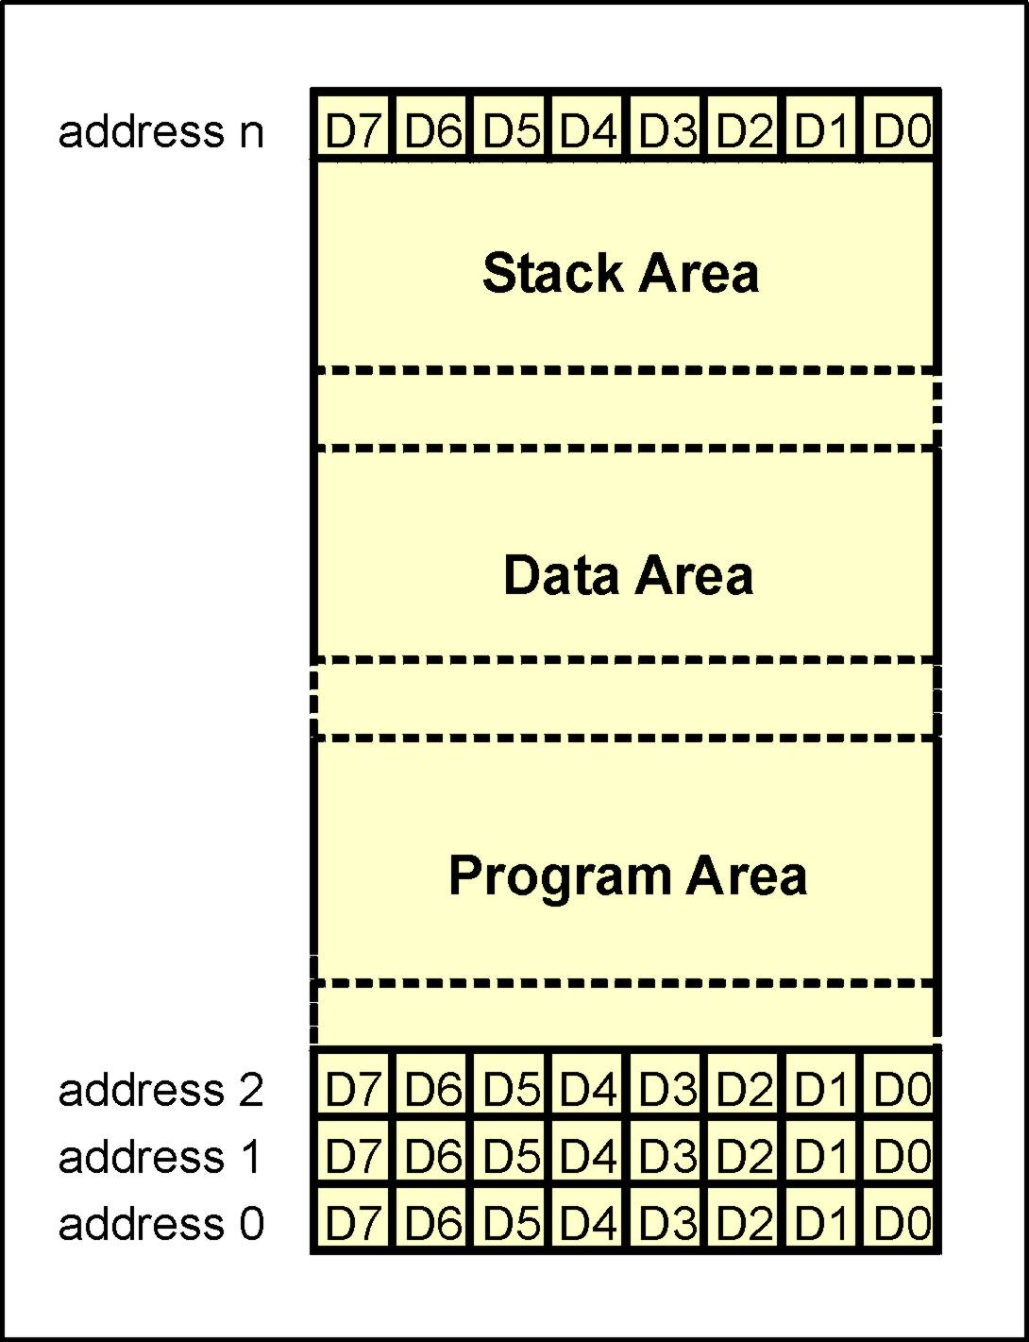
Memory System
The memory system of a digital computer can be considered to comprise three separate areas
  Program Area That section of memory used to store the program
  Data Area That section of memory used to store the data to be processed
  Stack Area That section of memory reserved for the stack (see later).

Slide 6
Input / Output Devices
Input / Output devices provide a communication interface between the digital computer and the outside world.
Examples of input devices are :
  a keyboard
  a mouse
Examples of output devices are:
  a printer
  a visual display unit

Slide 7
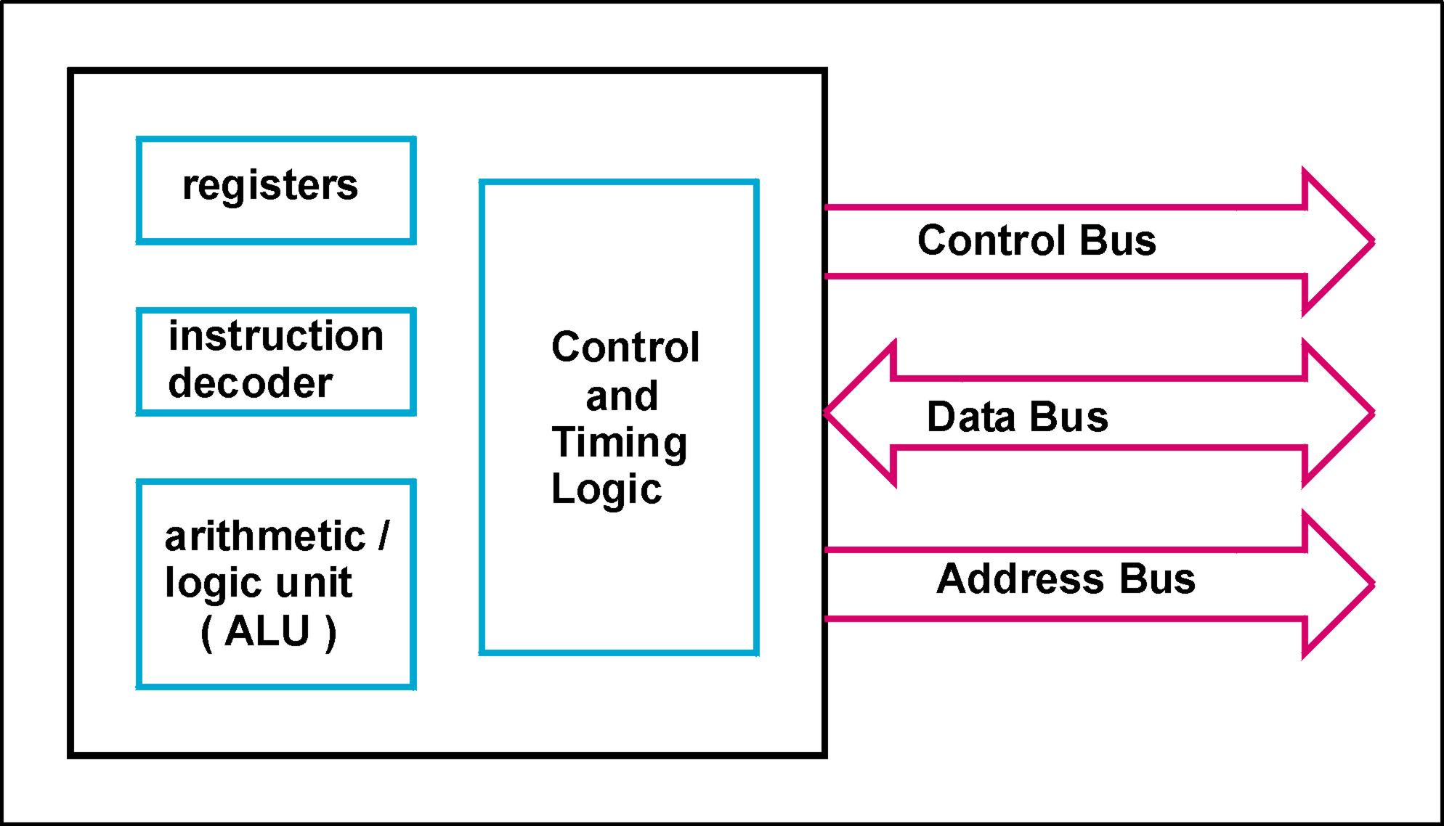
Microprocessor Interface

Slide 8
Busses
Busses are used to interconnect the sub-systems of a computer.
A bus is a multi-way set of electrical connections which share a common purpose.
Each bus line can carry one binary digit (Bit)
Thus to convey 8-bits of information from one sub-system of a computer to another, simultaneously, requires an 8-bit bus.
8-bits, collectively, is called a byte. Data busses of most computers are byte wide or an integer multiple of bytes wide.

Slide 9
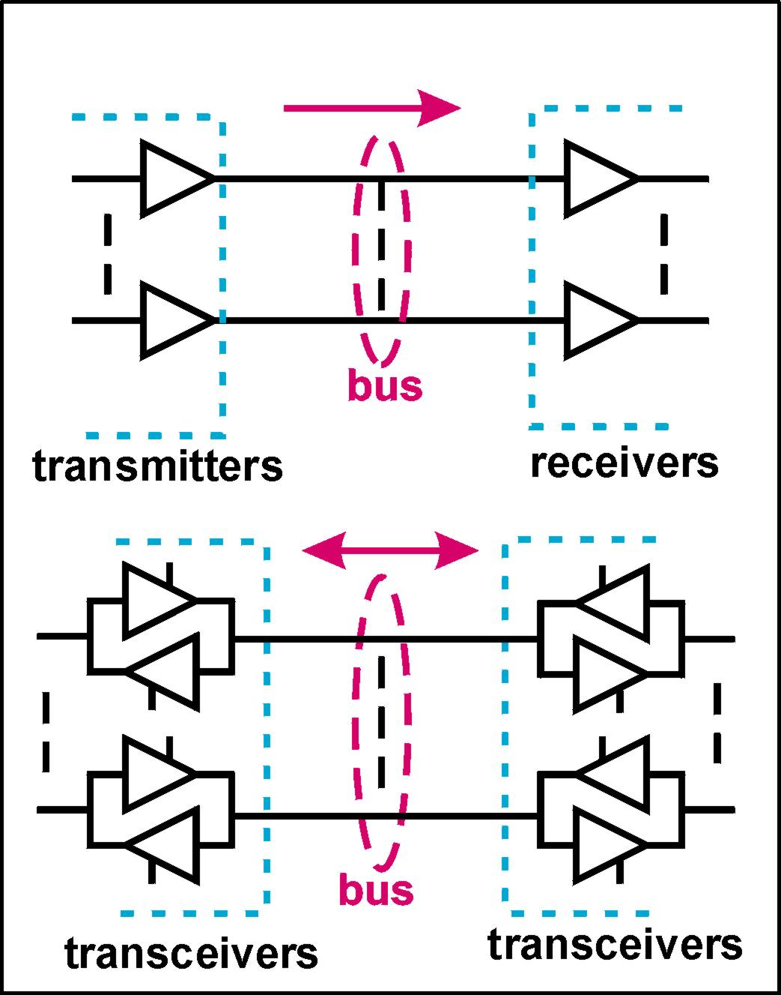
Unidirectional and Bi-directional Busses
A unidirectional bus can carry binary information in one direction only - from transmitter to receiver.
A bi-directional bus can carry binary information in either direction. However it can only carry information in one direction at any instant of time.
Bi-directional busses are terminated in transceivers. A transceiver is a back-to-back pair of tri-state logic gates.

Slide 10
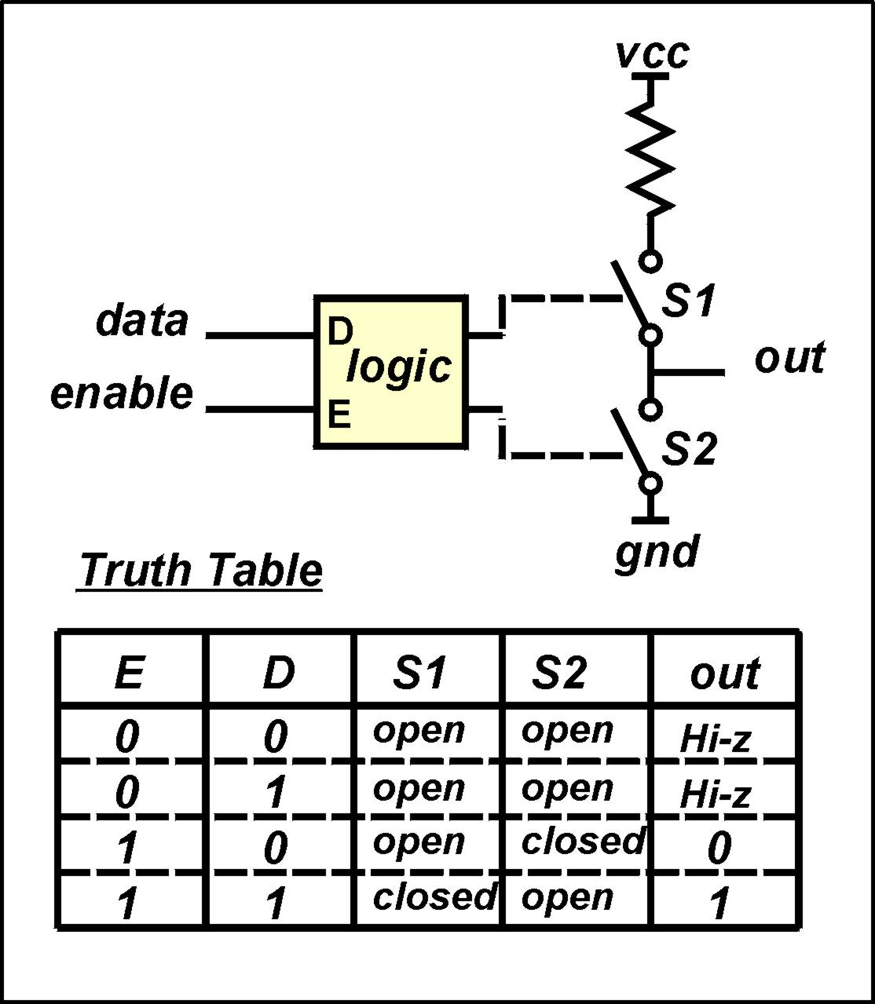
The Tri-state (Hi-z) Concept
A non-inverting tri-state buffer is a non-inverting gate with two inputs, an enable input and a data input.
When the enable input is at logic ‘0’ both output transistors are open and the output of the device is open (Hi-z)
When the enable input is at logic ‘1’ one output transistor is closed. The output is determined by the data input i.e. when D=1, S1 is closed and out=1 and when D=0, S2 is closed and out=0.

Slide 11
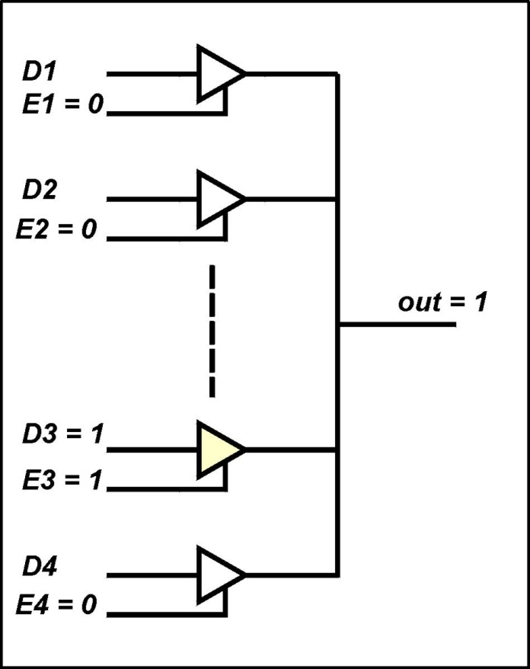
The Tri-state (Hi-z) Concept
The outputs of any number of tri-state gates may be connected without problem provided only one of the tri-state gates is enabled at any instant of time.
The common line (bus line), which interconnects the outputs of the tri-state gates, will have a logic level determined by the tri-state gate that is enabled

Slide 12
Bus Functions - Address Bus
The address bus is used by the CPU to specify which memory location ( or input/output device ) it wishes to access.
In simple systems the address bus is a unidirectional bus with the CPU as the transmitter and memory and I/O devices as receivers.
An address bus x-bits wide enables a CPU to uniquely identify any one of 2^{x} location.

Slide 13
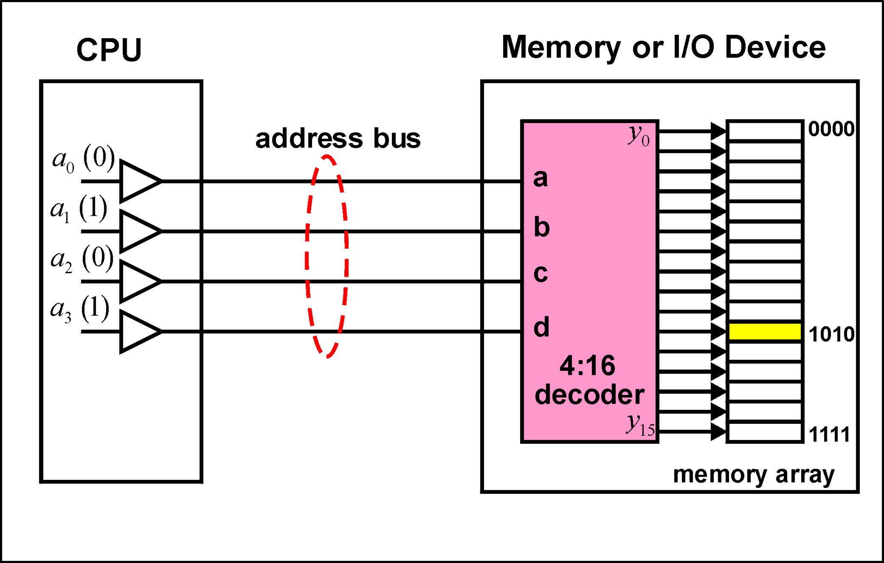
Address Bus - Example

Slide 14
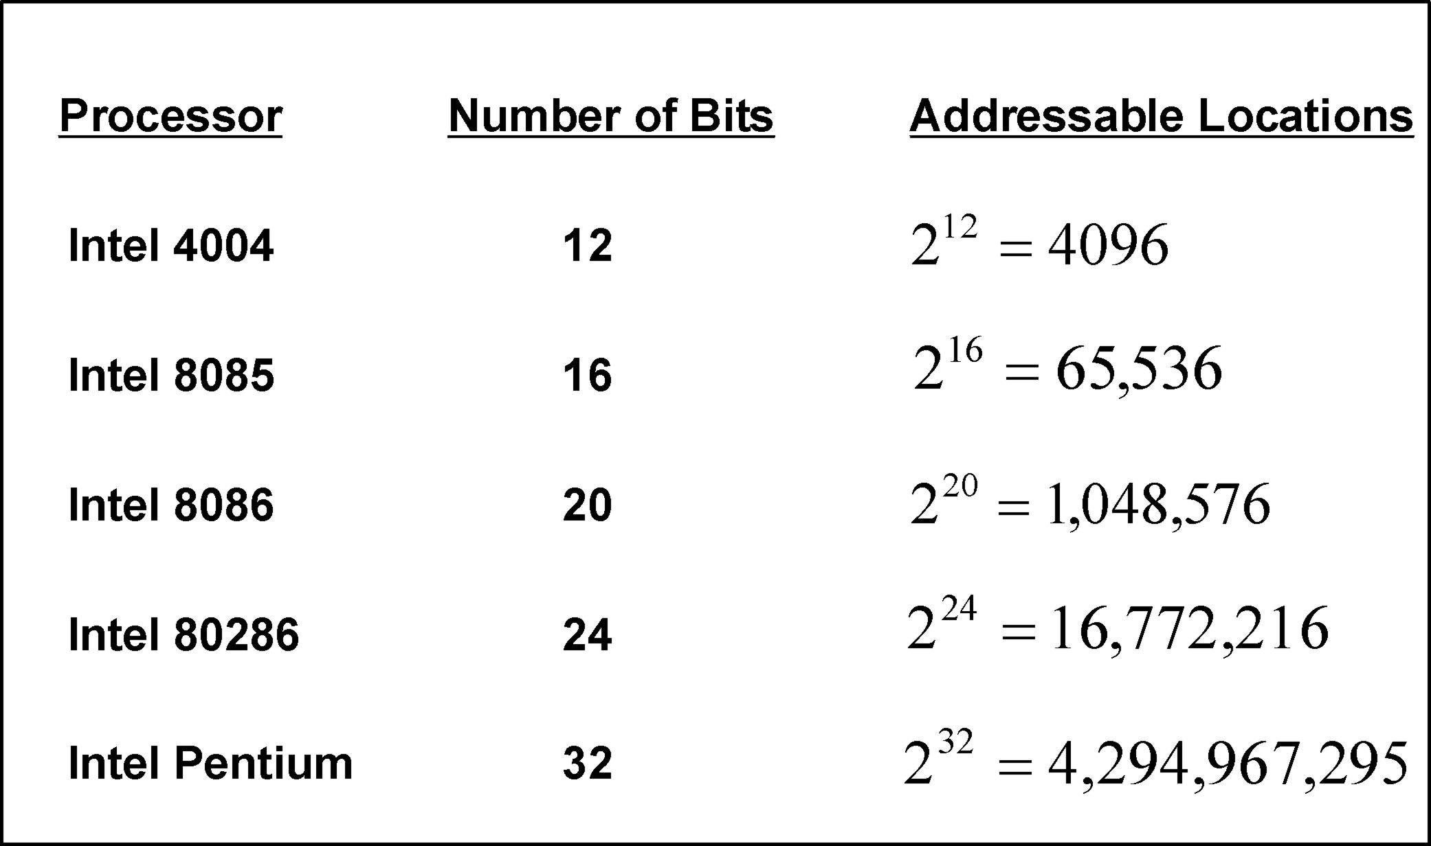
Address Bus Widths

Slide 15
Data Bus
The Data Bus is the bus over which the binary data, stored at an addressed location, is transferred to/from the CPU.
The data bus is a bi-directional bus.
Data can be transferred from the processor to an addressed location - a write operation.
Data can be transferred to the processor from an addressed location - a read operation.
Data bus widths correspond to the number of binary digits stored at a location - usually an integer multiple of 8.

Slide 16
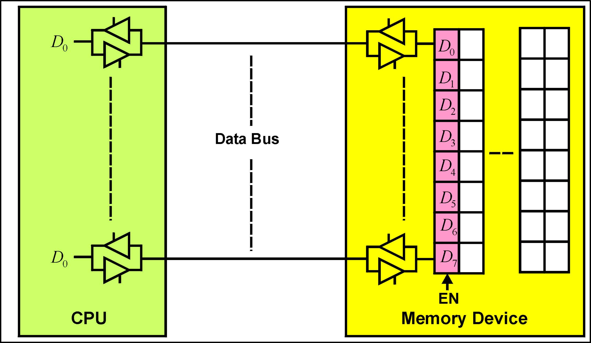
Data Bus - Example

Slide 17
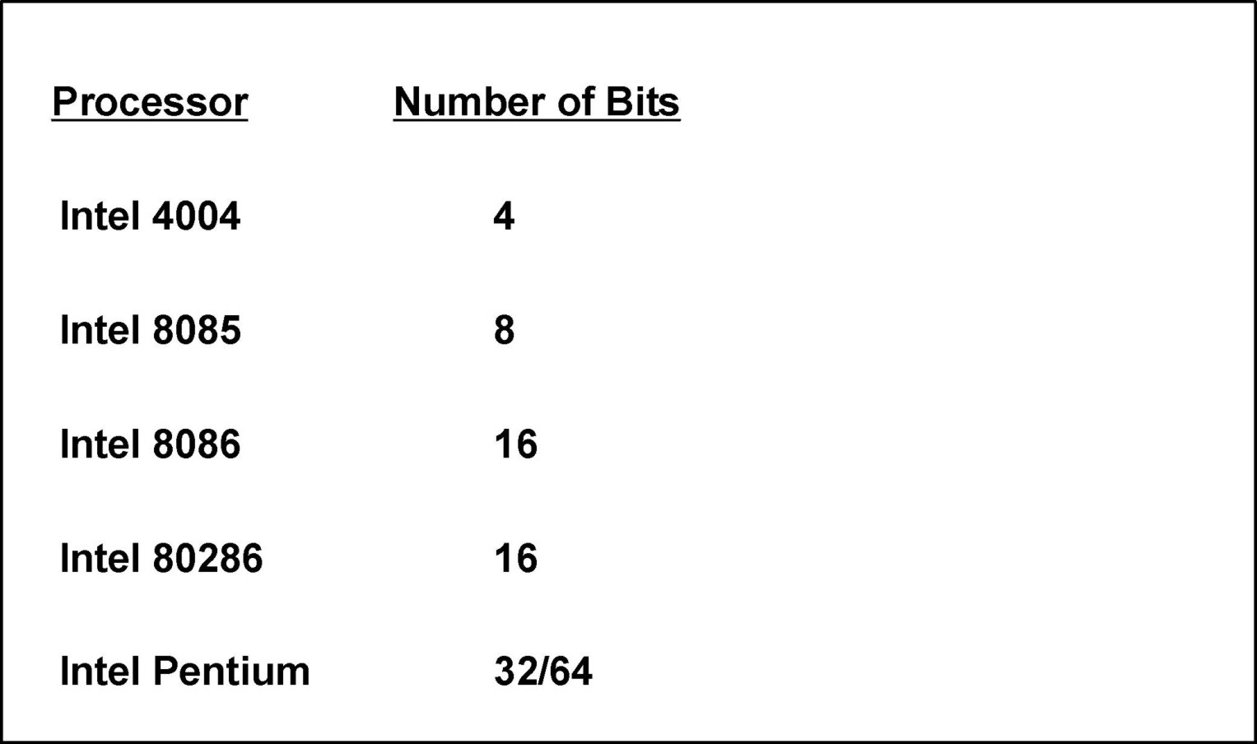
Data Bus Widths

Slide 18
Control Bus
The control bus is a unidirectional bus
Some control signals are processor outputs, thus enabling the processor to instruct peripheral devices as to the particular type of operation it wishes to execute.
Some control signals are processor inputs, thus enabling peripheral devices to provide control information to the processor.

Slide 19
Some Typical Control Signals
/RD (Output)
Tells peripheral devices that the processor wishes to read
data from the addressed location
/WR(Output)
Tells peripheral devices that the processor wishes to write
data to the addressed location
RDY(Input)
The peripheral device tells the processor it is ready to
proceed with a data transfer (read or write as appropriate)

Slide 20
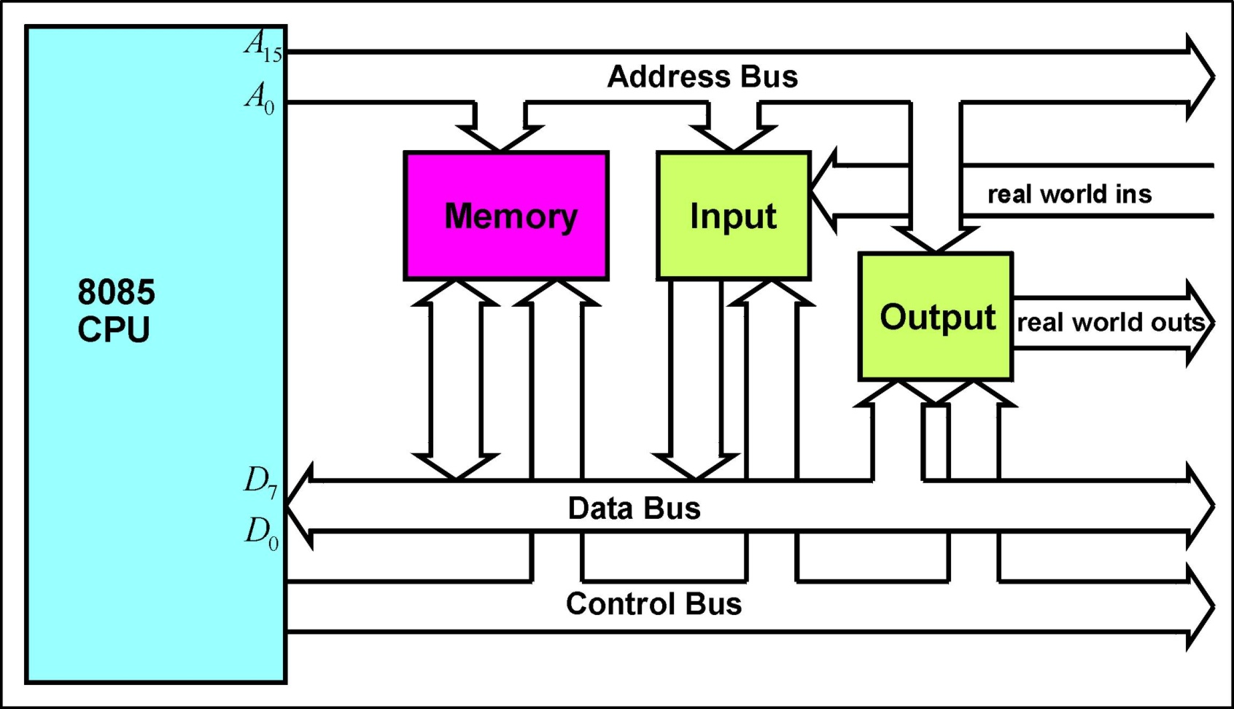
8085A Microcomputer Bus Organization

Slide 21
Questions
© 2015 ELSIVER, All rights reserved. compiled by Dr. Osama Hosameldeen

